Slide 1
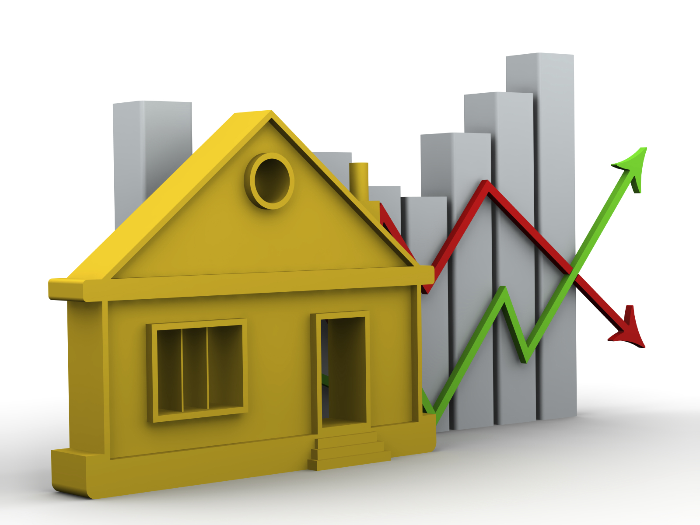
How to predict the price of a house

Slide 2
Index
Overview
House characteristics: the correlation with price and market trends
Data Exploratory conclusions
Best model to predict

Slide 3
Overview
A real estate and construction company in King County in Washington State (USA) wants to know at what price they should sell houses in that area. Also, they want to know where build houses and what characteristics this houses should have in order to see results in profit.
The goal of this presentation is to understand and analyze Real Estate features and their effect on market price for this location using a data set that consists on information on 22,000 properties sold between May 2014 to May 2015.

Slide 4
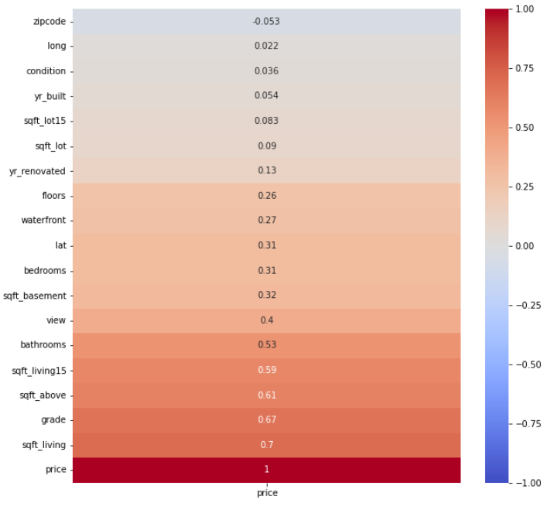
Data exploratory conclusions
Correlations with price:
Size is high correlated (sqft_living, sqft_above, etc)
Grade are strongly correlated but not the condition
Because waterfront and condition are not well correlated, the grade is the reason why houses around Washington Lake are the most expensive houses.
Age of the house (yr_built) and renovations are not affecting the price of a house
The zipcode is not representative of location that’s why it’s not well correlated
Market trends:
3 and 4 bedrooms
1 to 2.5 bathrooms
Condition 3 (range 2-5) and grade 7
Mostly located around washington lake and Seattle
The majority of the houses are not renovated. For renovated, the range of 40-60 years until renovation have the highest frequency

Slide 5
Best model to predict the price of a house
Considerations: based on previous slides, I decided to dummify “zipcode” and also, I will drop the column “yr_renovation”

Slide 6
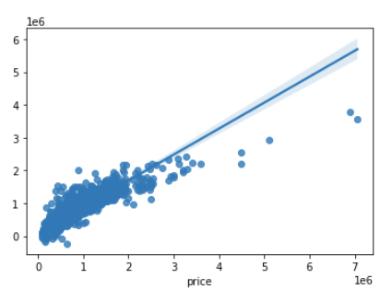
Benchmark and Standard scaling
LinearRegression
Standard Scaling
01
R2: 0.7964
Mean_squared_error: 164301.6945
Mean_Abs_error: 26995046833.1038
R2: 0.79408
Mean_squared_error: 163748.3463
Mean_Abs_Error: 26813520929.8285

Slide 7
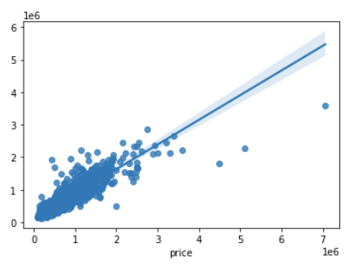
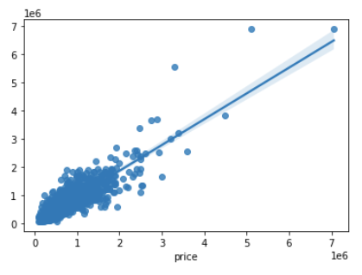
KNN and Decision Tree
KNN
Decision Tree
01
R2: 0.8086
Mean_squared_error: 157835.0312
Mean_Abs_error: 24911897096.937935
R2: 0.7885
Mean_squared_error: 165928.4247
Mean_Abs_error: 27532242138.903126

Slide 8

Thank you.

